Slide 1


Unlocking Digital Potential​ A Hands-on Coding Workshop
Selmane Tabet (selman.io)
Outreach Officer at Cardiff University School of Computer Science
Paul Brennan
Professor in Medical Education, Cardiff University & Rhiwbina Library Code Club​
Gareth Gwyther
Senior Engineer, LexisNexis Risk Solutions & Rhiwbina Library Code Club​
Notes:
Selman starts off and hands over to Paul and Gareth

Slide 2
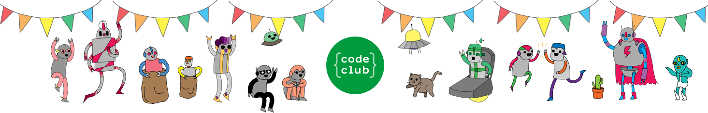
Why run a code club?
Looks of amazement and empowerment from your learners.
Joy of parents when they see what their children have done.
Inspire the first steps in a journey to becoming a software engineer.
Notes:
Paul and Gareth talk through this then hand over to Selman.

Slide 3
What does it take to run a code club?​
Interest and motivation – appeal to curious audiences.​
Computers; the most straightforward medium of coding.​
Anything else would depend on specific content.
There are loads of resources for free!
Notes:
Selman talks through this and briefly hands over to Paul and Gareth. Feel free to softly interject if there is anything of value to add.

Slide 4
Key points for running code clubs…
Keep it fun
For the children
And for you!
Make sure all involved staff have a DBS check.
Be careful about safeguarding – Code Club will provide training
Attention is scarce, so make explanations snappy and short.​
Patience is key, not everyone will get it first time around.
Notes:
Speakers can be alternated here as there is quite a few tips to speak about here. Paul and Gareth can mainly speak through this but Selman pitches in on DBS, safeguarding, maintain attention and engagement. Play this by ear, but feel free to step in whenever appropriate. Hand over to Selman towards the end.

Slide 5
Common difficulties
Equipment that doesn’t allow flexible usage
Firewalls
Installing software
Learners might lose interest halfway through.
Internet access and speeds.
Notes:
Selman primarily speaks here.

Slide 6
Reflections on 8 years of Code Club
Kids make you laugh.
Have met some very inspiring and talented children.
Learning programming skills.
Notes:
Paul and Gareth speak here.

Slide 7
Quote from a former Code Club alumni
I was learning Python on my own, the book was out of date and the code would not compile and kept throwing errors…
I walked into a Code Club and go the help I needed.
I looked around the room and saw it was my tribe…
Notes:
Paul and Gareth keep speaking here.

Slide 8
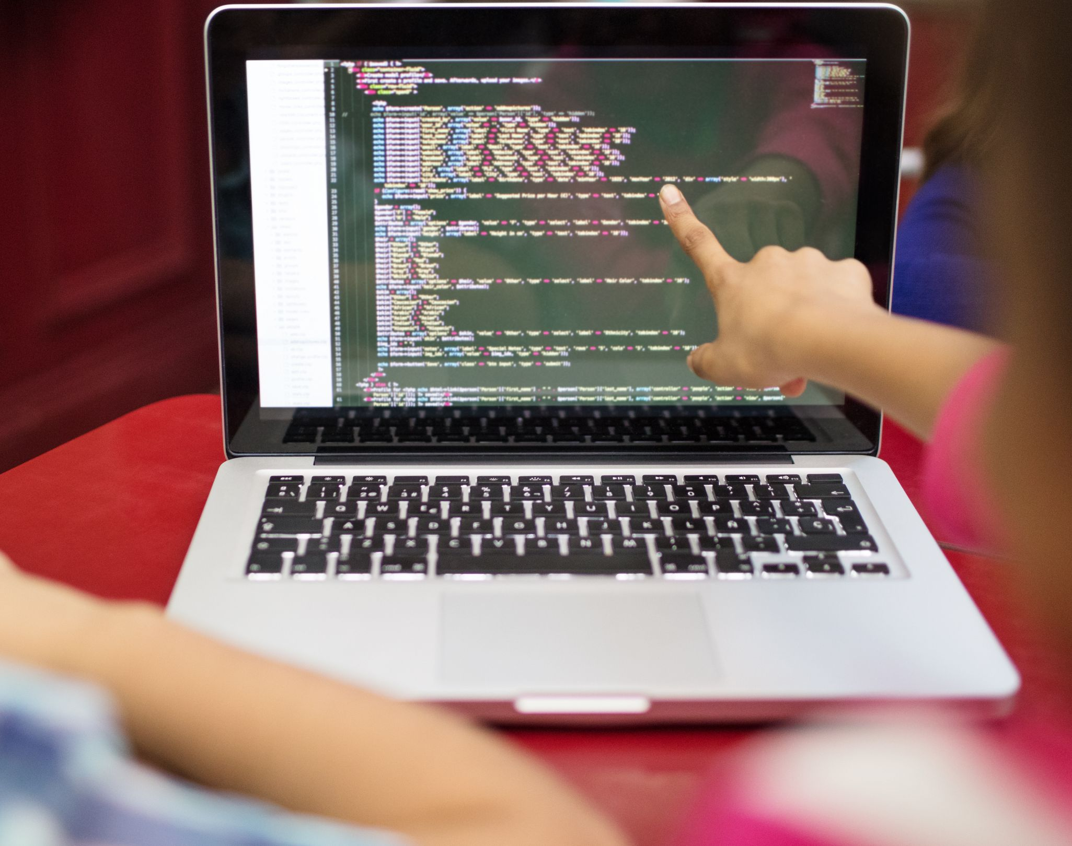
Can you do this online?
Yes, but it has its challenges
Relying more on online tools
Harder to diagnose problems on students’ side
Thus, lessons can be a bit slower.
Notes:
Selman speaks here.

Slide 9

Any questions before we go through the demo?

Slide 10

Let’s explore some sample lessons
Scratch activity:
https://projects.raspberrypi.org/en/projects/lost-in-space
Python Project activity:
https://github.com/brennanpincardiff/rhiwbina_codeclub_projects/blob/master/python_shapes.md
Microbit lesson:
https://projects.raspberrypi.org/en/projects/music-player

Slide 11
Times up… Any final questions?

Slide 12

Free and useful resources
Raspberry Pi/Code Club Projects site: https://projects.raspberrypi.org/en
Trinket for coding online (https://trinket.io/python)
Google CoLab (https://colab.research.google.com/)
Github Code spaces (https://github.com/features/codespaces)
The links for today:
https://github.com/brennanpincardiff/rhiwbina_codeclub_projects/blob/master/BIG_session_plan.md

